Slide 1
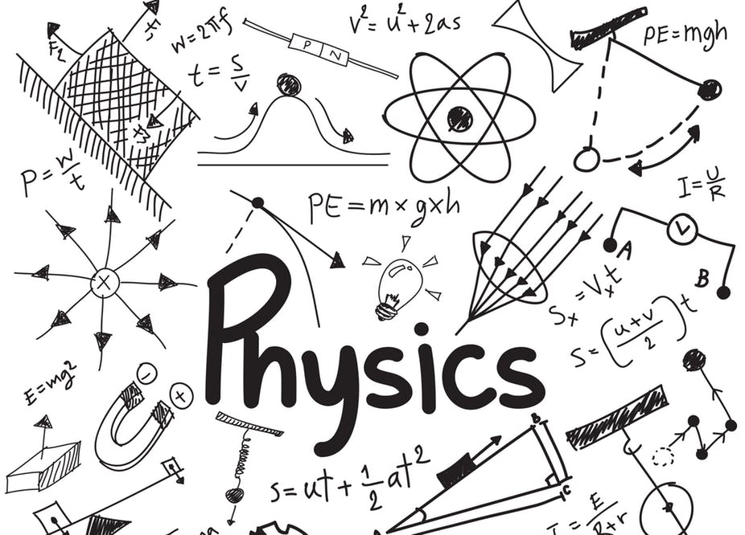
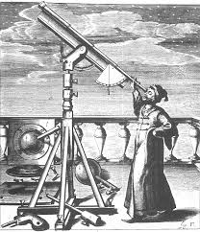
Frontiers in Physics and Astrophysics
Physics 224 – Introduction to Physics of the Universe
Barry C Barish
1-April-2020

Slide 2
Frontiers in Physics and Astrophysics
Physics 224 – Introduction to Physics of the Universe
Explore frontiers of Physics and Astrophysics from an Experimental Viewpoint
Some History and Background for Each Frontier
Emphasis on Large Facilities and Major Recent Discoveries
Discuss Future Directions and Initiatives
----------------------------------------------------------------------
Wednesdays: Lectures 11am to 1 pm
Thursdays: Discussion Session 11am - noon
------------------------------------------------------------------------------
Attend and Participate in Classes
Student Projects – Pick a ‘Forefront Topic’ and give a 20 minute presentation and 5-10 page write-up

Slide 3
Physics 224 - Barry C Barish
Frontiers 1
Course Title: “The Frontiers of Physics and Astrophysics / An Experimental Viewpoint”
The Course will consist of 30 Lectures over 10 Weeks
1- April 2020 - Introduction to ‘Physics of the Universe’ 8 –April 2020 - Intro to Elementary Particles 15 –April 2020 - Particle Accelerators 22 –April 2020 The Standard Model of Particle Physics 29 –April 2020 Higgs Boson and the Future of Particle Physics 6 – May 2019 - Neutrinos 13 – May 2020 - Neutrino Oscillations 20 – May 2020- Gravitational Waves 27 – May 2020- Gravitational Waves 3 – June 2020 - Dark Matter, Dark Energy, Future Perspectives
All Lectures and the supporting teaching materials will be published by the Physics Department.

Slide 4
Frontiers 1
Barry Barish – Who am I ??
https://en.wikipedia.org/wiki/Barry_Barish
Born Omaha, Nebraska; moved to Los Angeles when 10 years old.
I went to public schools; I thought I would become either a tennis player or novelist as a kid
I went to University of California, Berkeley to study engineering, but became excited by discovery in physics, and got BA and PhD in Physics in Berkeley
I came to CALTECH as a postdoc, became faculty and stayed ever since.
My career began in EXPERIMENTAL particle physics: Proton-Antiproton Annihilation; Studies of Tau Lepton; Electron scattering - study structure of Proton; Neutrino Physics; Search for Magnetic Monopole; International Linear Collider; and Gravitational Waves
Nobel Prize in Physics (2017)

Slide 5
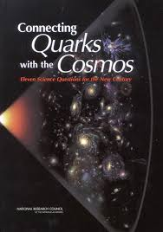
Connecting Quarks to the Cosmos (~18 years ago)
Frontiers 1
National Academy of Sciences Study published in 2002.
“… Astronomical Discoveries are driving the frontiers of elementary particle physics, and more than ever before our knowledge of the elementary particles is driving progress in understanding the universe and its contents.”
They pose “Eleven Questions for the New Century”
The report -
https://www.nap.edu/read/10079/chapter/1
The 11 questions –
https://www.nap.edu/read/10079/chapter/9#133
Notes:
Physics is usually taught from a conceptual point of view, explaining as best we can the laws and applications of physics, as well as the primary experimental discoveries. My approach will be a little different. I will be treating physics as a dynamic subject that evolves as we learn more. I will illustrate this historically and discuss the present understanding, both in terms of how we got to where we are, and the prospects and plans for the future.
Let’s start with a short historical view, BUT RECENT HISTORY. I do this to show how physics is a dynamical subject, even on rather short time scales. By going back only 15-20 years, we will look then at what was the status of fundamental physics then, and what were considered the key questions, and moving to now, which we have answered and how, which remain, and what new questions we have today.
Let’s project ourselves back to the early two thousands. What did we know and what were the key questions for the future. An illustration of that is a serioius report written by a committee of prominent physicists in a U.S. National Academy of Sciences study. The study was called – Quarks to the Cosmos. The title is prophetic, because since that time, particle physics and astrophysics have become much closer together.

Slide 7
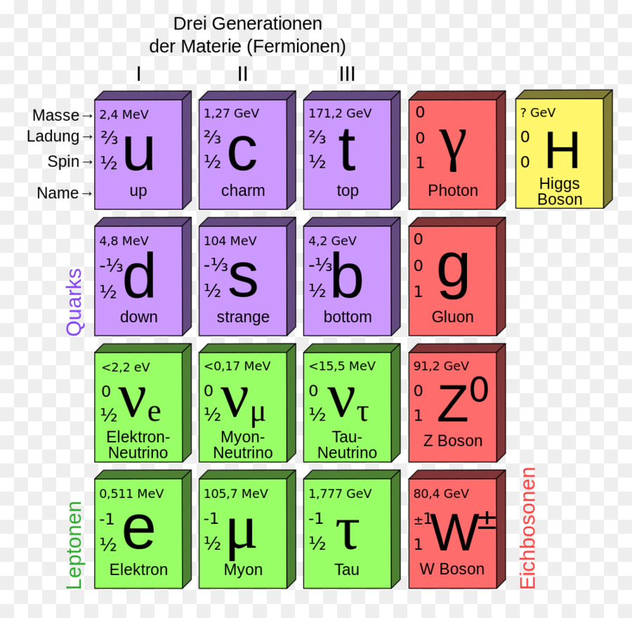
Frontiers 1
What we know: Constituents of the Standard Model
Discovery announced
July 2010
Notes:
The Standard Model of Particle Physics. This chart is a summary of many of the key elements of what we call the Standard Model (I will describe later). The fundamental building blocks of nature – the quarks and the leptons are shown, as well as the force particles for the strong, electromagnetic and weak forces. We will explore and explain the main ideas and experimentation that enables making this summary chart and the implications in terms of particles and their interactions will be explained over the next few lectures. We will also see what is in this chart that we have still to explain …. And that is why it is called a ‘model,’ not a theory.
Notice that this figure is deceptively simple, but each particle has detailed information and roles, there are types of particles … e.g. leptons and quarks, there are three families of constiuents, there are four force particle and there is the recently discovered Higgs particle, responsible for creating the masses of these constiuents.

Slide 8
Frontiers 1
What we know: Discovery of the top quark at Fermilab
The discovery of the top quark at Fermilab. Proton-Antiproton collisions at high enough energy produce the reaction above. A pair of top quarks is produced, each of which has about the mass of a gold atom. The top quark decays quickly into lighter particles. The Collider Detector Facility (CDF) is shown above.
Notes:
Note that this is my first illustration of large scale experimentation, in this case a large particle accelerator at Fermilab colliding protons at 1 TeV in the center of mass system, and very sophisticated detectors that could identify and measure the characteristics of the emerging collisions.
(I will then explain the slide, using the text below the figures)

Slide 9
Frontiers 1
What we know: Hadrons and the Strong Force
Many short-lived (~10⁻²³ sec) particles were discovered in the 1960s
And important differences:
leptons were point-like
hadrons had spatial extent
Point-like
Notes:
The big advances using particle accelerators during the last half of the 20th century established that there are very many short-lived particles discovered, leading to an understanding of the quark-like structure, which we will come to. In terms of interactions, a crucial feature is that hadrons have a spatial extent characterized by the formula shown.

Slide 10
Frontiers 1
What we know: Quantum Chromodynamics - Strong Force
Quantum Chromodynamics (QCD) describes the strong force, above over 11 orders of magnitude. The data is from high-energy proton-antiproton collisions at Fermilab’s Tevatron. The production of jets of quark and gluons carries the energy on the horizontal axis, transverse the beam direction.
Notes:
This amazing graph shows the impressive agreement between data and theory over 11 orders of magnitude and represents the very strong confirmation that Quantum Chromodynamics describes strong interactions between particles from glancing collisions (low transverse energy) to very hard collisions (large transverse momentum). I will describe the general features of QCD in a later lecture.
The discovery of the top quark, and the theory QCD were the two leading discoveries of the 1990s. In addition for particle physics, it was dominated by the success of the standard model. The top quark was the remaining missing constituent in the Standard Model of particle physics, and Quantum Chromodynamics gave an understanding and ability to calculate the dynamics of strong interactions and the confinement of quarks. We will cover that physics.

Slide 11
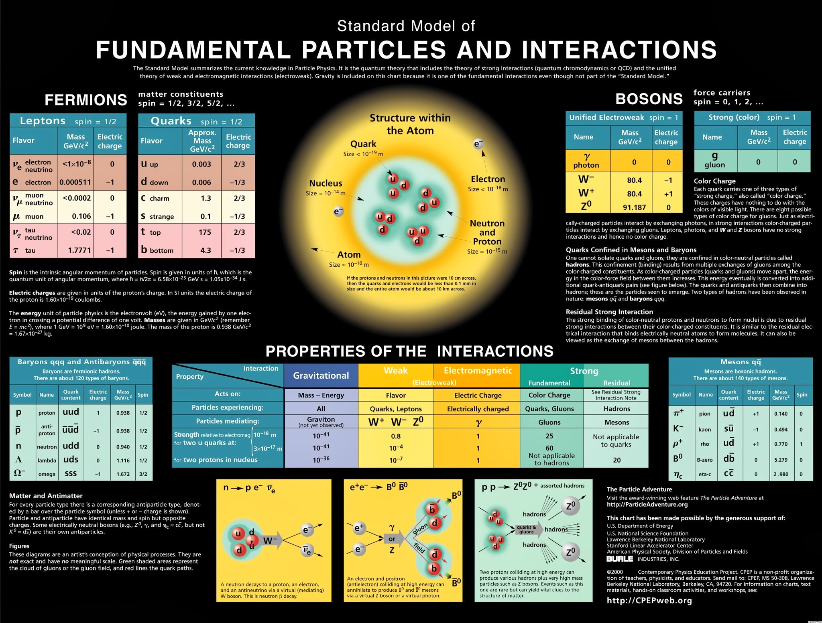
Frontiers 1
Particle Physics: What we Know
Notes:
This is a more complete description of what we know about particle physics. The quark like structure of matter is shown in the middle top; the properties of the four interactions are shown in the bottom middle; some of the processes and important questions in the field are shown at the bottom of the chart.

Slide 12
The Goals of Particle Physics (2001)
Frontiers 1
Notes:
Lets begin by going back to the beginning of this new century. This illustrates both some of the key questions and goals in the field, as of that time, and we will be able to see how and what progress has been achieved. We also will see what questions have not been answered, and what new questions we have 19 years later. In the year 2000, I co-chaired a US Department of Energy study of the future of particle physics with Professor John Bagger, a particle theorist, who is now the Director of the TRIUMF Laboratory in Vancouver, Canada. The purpose of the study was to assess the status of the particle physics field and to set the priorities and goals for the coming years. The committee consisted of a group of prominent mostly U.S. physicists, representing experiment and theory, and spread over the subfields of particle physics.
Our view of physics and the future goals is illustrated in this drawing. The science of particle physics we described as “the Science of Matter, Energy, Space and Time” That’s a very broad definition of particle physics, which historically was described in a more limited way as particles and their interactions. The goals of particle physics, as we saw it in 2001 was to ultimately to ask and answer questions that could lead toward “Ultimate Unification,” “Hidden Dimensions” or “Cosmic Connections” For each, there are a set of experimental paths like studying neutrinos, understanding the Higgs phenomena, finding the dark matter of other connections to astrophysics. In this lecture series, we will update this approach and talk specifically about frontier experiments: past, present and future.

Slide 13
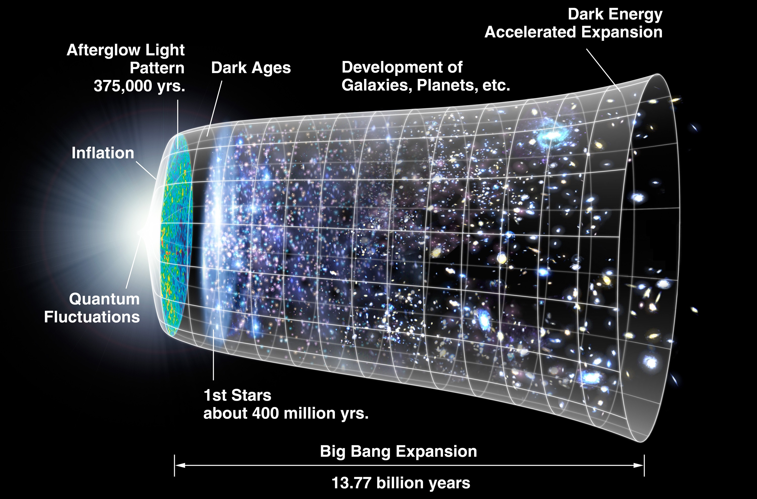
Frontiers 1
Physics – An Inquiry Based Science
Physics of the Universe Report: “Connections Quarks to the Cosmos” Some Questions
How Did the Universe Begin?
There is evidence that during its earliest moments the universe underwent a tremendous burst of expansion, known as inflation, so that the largest objects in the universe had their origins in subatomic quantum fuzz. The underlying physical cause of this inflation is a mystery.
Notes:
Physics – An inquiry based science. Most of physics is “inquiry based,” while astonomy is “observation based.” That is we ask and try to answer questions, rather than explore and explain observations. This is not strictly true, but is central approach.
One of the biggest questions that we all would like to understand is “How did it all begin?” We have a pretty well accepted ‘big-bang’ theory and a story of how the universe has evolved since that time 13.7 billion years ago.
The biggest question perhaps is why we live in a “matter dominated universe.” In the first instants of the big bang when energy was converted to particles, it made both particles and antiparticles, but why not an equal number, in which case they would have totally annihilated and we would not be here. So, there was a small asymmetry and most annihilated, but some matter remained. Today, we still have no good theory for that, but have ideas and some models for how that may have happened. Of course, we need experimental information to understand what the early universe was in reality, and that remains to be done in the future.

Slide 14
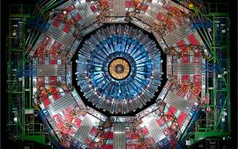
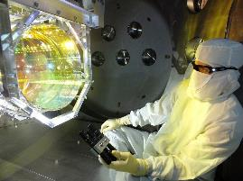
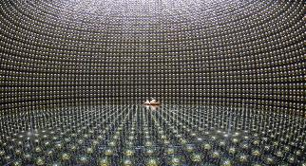
Frontiers 1
MAJOR DISCOVERIES IN PHYSICS/ASTROPHYSICS
Large-Scale High Technology Projects
LHC
High Technology
Accelerator & Detectors
LIGO
High Technology
Intererometers
SuperKamiokande
High Technology
Underground Array
Discovery
Higgs Boson
Discovery
Gravitational Waves
Discovery
Neutrino Mass/Oscillations
Notes:
First, let me emphasize that since 2000 and the Quarks to Cosmos study, of course, we haven’t answered all the questions posed in Quarks to the Cosmos, but we have made very significant progress. We are in an era where the advances in technology, coupled with large international collaborations have led to developing unprecedented large-scale experimental facilities that are making incredible advances and discoveries in physics and astronomy. Just since the new millennium, the three biggest and historic discoveries in fundamental physics have been 1) Neutrino Mass and Oscillations, 2) the discovery of the Higg‘s Boson, and 3) Gravitational Waves (the subject of todays talk). All three were only possible by large-scale international high technology facilities.

Slide 15
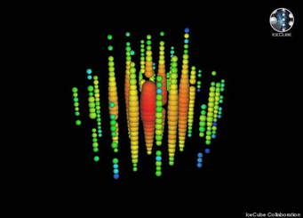
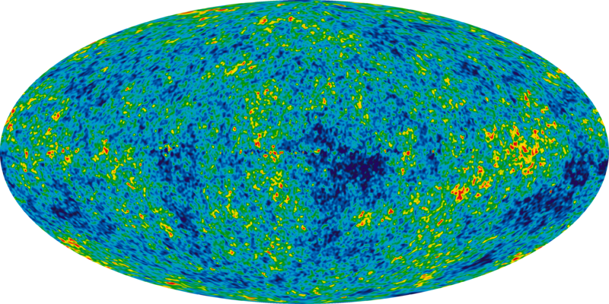
Frontiers 1
MAJOR DISCOVERIES IN PHYSICS/ASTROPHYSICS
Large-Scale High Technology Projects
ICE CUBE
High Technology
South Pole
WMAP
Satellite
Discovery
Early Universe
Discovery
Neutrinos from a Blazar
Notes:
Beyond these major discoveries we have made very large advances in various areas of fundamental physics. For example, we have begun to do astronomy with probes beyond the electromagnetic spectrum. Using neutrinos in the Ice Cube detector at the South Pole, they have seen evidence for neutrinos coming from an astrophysics source -- Blazars. And using detection of the microwave background, we have learned a tremendous amount about the early universe.

Slide 16
Frontiers 1
Physics – An Inquiry Based Science
Physics of the Universe Report: “Connections Quarks to the Cosmos” (Some Questions asked in about 2005)
What Is Dark Matter?
Astronomers have shown that the objects in the universe, from galaxies a million times smaller than ours to the largest clusters of galaxies, are held together by a form of matter different from what we are made of and that gives off no light. This matter probably consists of one or more as-yet-undiscovered elementary particles, and aggregations of it produce the gravitational pull leading to the formation of galaxies and large-scale structures in the universe. At the same time these particles may be streaming through our Earth-bound laboratories.
Notes:
Interestingly, we can compare astronomy and particle physics as sciences. Astronomy is primarily an observational science. New instruments (e.g. telescopes) are developed to ‘observe’ the universe in different ways, different wavelengths, etc. New observations and discoveries lead to new scientific understanding of our universe. In particle physics, we develop questions from what we understand and what we don’t understand, and instruments are developed to address those questions. We call that an ‘inquiry based’ science.
The challenges listed in the National Academy Study can be described as ‘inquiry-based’ questions and science. I will briefly go through those listed to set the stage for the next few lectures; what we have learned and what we are trying to learn about particle physics.
The first question to be understood is “Dark Matter” Read description on the slide.

Slide 17
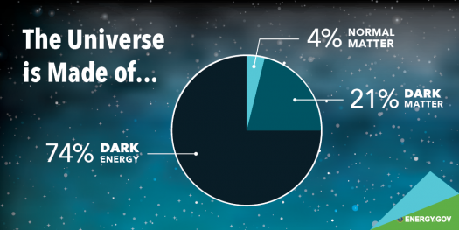
Frontiers 1
What is the Universe Made of?
Notes:
Interestingly, the Universe we know represents only about 4% of the total matter/energy in the universe. In fact, dark matter is another 25% and there is much experimentation trying to identify the dark matter. Dark energy is a big puzzle and the first task is to understand more about it, so we can try to understand what it is and how it affects the universe.

Slide 18
Frontiers 1
Physics – An Inquiry Based Science
Physics of the Universe Report: “Connections Quarks to the Cosmos” Some Questions
What Is the Nature of Dark Energy?
Recent measurements indicate that the expansion of the universe is speeding up rather than slowing down. This discovery contradicts the fundamental idea that gravity is always attractive. It calls for the presence of a form of energy, dubbed “dark energy,” whose gravity is repulsive and whose nature determines the destiny of our universe.
Notes:
Read Slide.

Slide 19
Frontiers 1
Physics – An Inquiry Based Science
Physics of the Universe Report: “Connections Quarks to the Cosmos” Some Questions
Did Einstein Have the Last Word on Gravity?*
Black holes are ubiquitous in the universe, and their intense gravity
can be explored. The effects of strong gravity in the early universe
have observable consequences. Einstein’s theory should work as well in these situations as it does in the solar system. A complete theory of gravity should incorporate quantum effects—Einstein’s theory of gravity does not—or explain why they are not relevant.
Notes:
Read the text on the slide.
Finally, we have two theories of fundamental physics: Einstein’s theory of General Relativity (gravity), which describes physics at long distances and high velocities and accelerations; and we have quantum field theory of quantum physics that describes physics at very short distances. How do we reconcile these and develop ONE theory of physics?

Slide 20
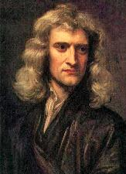
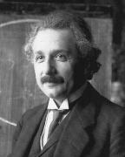
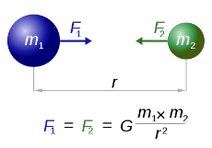
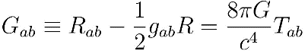
Frontiers 1
Einstein’s Gravity
Newton’s Theory of Gravity (1687)
Einstein’s Theory of Gravity (1915)
Universal Gravity: force between massive objects is directly proportional to the product of their masses, and inversely proportional to the square of the distance between them.
Space and Time are unified in a four dimensional
spacetime
Notes:
We all learned about gravity from Newton. He taught us that the force between two massive objects varies as the product of their masses and inversely as the square of their distance apart. His theory lasted more than 200 years, until Einstein brought forward his new theory of gravity. He had added acceleration to the Special Theory of Relativity (E = mc²). It is a four dimensional theory that unifies space and time. This new theory described the orbit of Mercury around the sun, The bending of light as observed in 1919 by Eddington, as well as gravitational waves. It is the theory that describes relativisitic astrophysics.

Slide 21
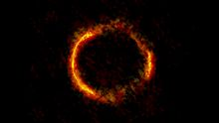
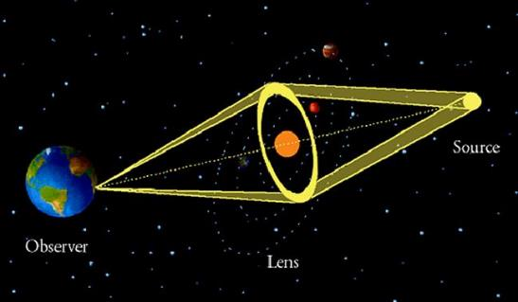
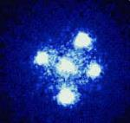
Frontiers 1
In Modern Astronomy: Gravitational Lensing
Einstein Cross
Notes:
An apt expression often used in physics is that yesterday’s discoveries are todays or tomrrows backgrounds. In other words, once we know something, it can become an obstacle to knowing more. Another outcome of a discovery though is that yesterdays discoveries often become todays new innovations or tools. An example in astronomy is Einstein’s bending of light, which can be used to ‘lens’ objects we could not otherwise see, gravitational lensing.

Slide 22
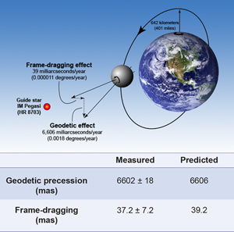
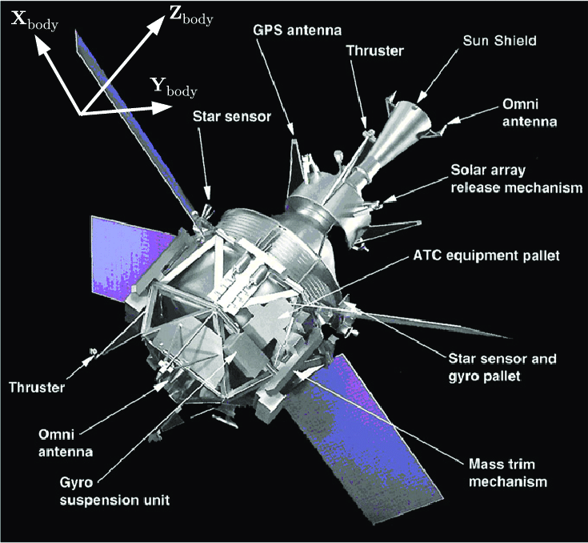
Frontiers 1
Testing Einstein’s Gravity
Gravity Probe B
Notes:
Testing Einstein’s Theory of General Relativity is very important. Although it works well for GPS that is in the weak field limit. Where GR may fail is in the strong field limit, which is being tested by LIGO with gravitational waves. Other tests include predictions tested with Gravity Probe B, a NASA satellite experiment. Tests of both Geodetic precession and frame-dragging agree to the accuracy of the measurements with Einstein’s theory.
Geodesic Precession = Equals motion of the axis of spinning object, for example the earth.
Frame Dragging = Effect of spacetime from the rotation of massive objects causes distortion of space time near another object causing a precesion

Slide 23
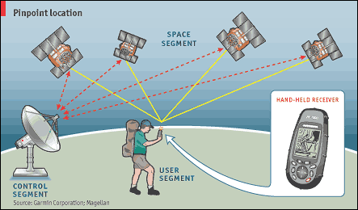
Frontiers 1
GPS: General Relativity in Everyday Life
Special Relativity
(Satellites v = 14,000 km/hour
“moving clocks tick more slowly”
Correction = - 7 microsec/day
General Relativity
Gravity: Satellites = 1/4 x Earth
Clocks faster = + 45 microsec/day
GPS Correction = + 38 microsec/day
(Accuracy required ~ 30 nanoseconds
to give 10 meter resolution
Notes:
General Relativity has everyday applications. The most evident is the Global Positioning System (GPS), which would not work without applying a correction for general relativity.
Talk about the description on slide.

Slide 24
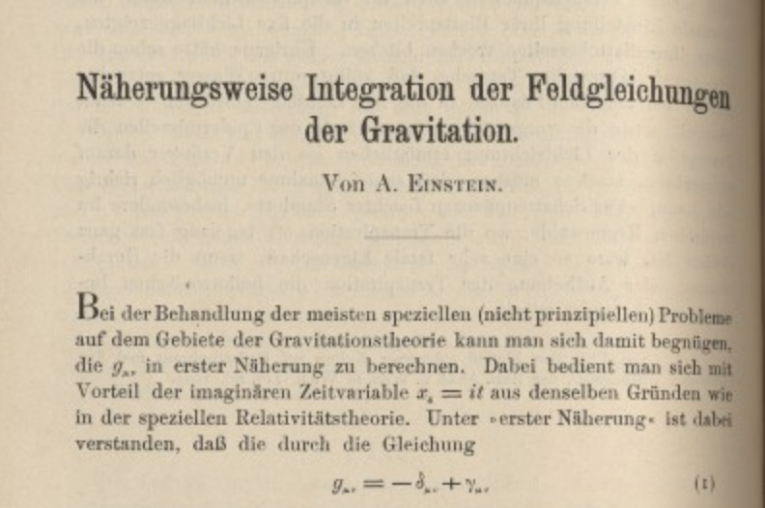
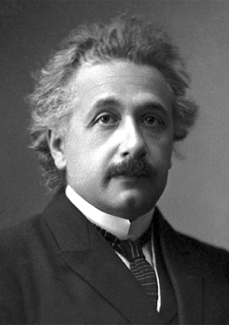
Einstein Predicted Gravitational Waves in 1916
Frontiers 1
1st publication indicating the existence of gravitational waves by Einstein in 1916
Contained errors relating wave amplitude to source motions
1918 paper corrected earlier errors (factor of 2), and it contains the quadrupole formula for radiating source
Notes:
One year after announcing his theory of General Relativity, Einstein published a paper that predicted gravitational waves. It took another forty years before Einstein and the broader General Relativity theory community fully believed in their existence. This was due to the theoretical subtleties in understanding whether they really exist in the theory. At this point (~1960), the problem became one for experimentalists to detect gravitational waves, or prove the theory wrong.

Slide 25
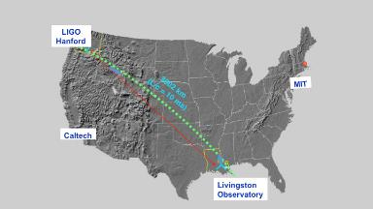
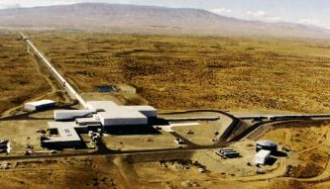
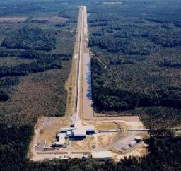
Hanford, WA
Frontiers 1
LIGO Interferometers
Advanced LIGO Suspensions / Seismic Isolation
Livingston, LA
Notes:
This is a view of LIGO, the detectors that discovered gravitational waves in 2015, and for which I was awarded the Nobel Prize. I will describe the experiment and gravitational waves in this lecture series in January.
The effect is extremely small, about 1/1000th the size of a proton. We used what is called an interferometer to make the observation of two black holes that collided 1.3 Billion years ago and the signal just arrived on the earth when we detected them.
We have two detectors, one in the state of Louisiana and the other in Washington State. I will describe them in January.

Slide 26
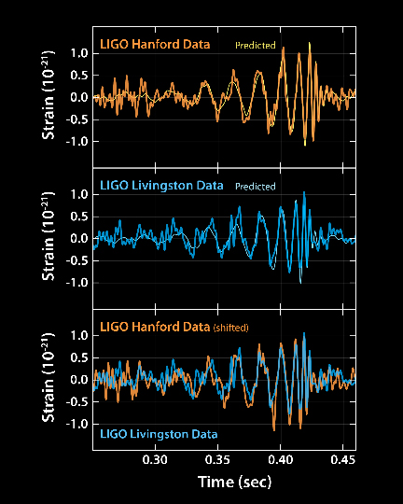
LIGO: Black Hole Merger: GW150914
Frontiers 1
LIGO vs Einstein
LIGO: first observation of gravitational waves from a binary black holle merger
Notes:
The data recording the black holes colliding is shown here. The vertical scale is 10⁻²¹ an incredibly small number and the reason it was so difficult to measure. It turns out that space is very stiff (lucky for us) and the distortions are very very small.
The data fit Einstein’s theory beautifully, as shown at in the top figure and the bottom frame indicates the velocity of the merging black holes are highly relativistic and only a few hundred kilometers apart when we observer them.

Slide 27
Frontiers 1
Physics – An Inquiry Based Science
Physics of the Universe Report: “Connections Quarks to the Cosmos” Some Questions
What Are the Masses of the Neutrinos, and How Have They Shaped the Evolution of the Universe?*
Cosmology tells us that neutrinos must be abundantly present in the universe today. Physicists have found evidence that they have a small mass, which implies that cosmic neutrinos account for as much mass as do stars. The pattern of neutrino masses can reveal much about how nature’s forces are unified, how the elements in the periodic table were made, and possibly even the origin of ordinary matter.
Notes:
Neutrinos are one of our most interesting and puzzling particles. I will spend some time later in this lecture series talking about neutrinos, especially since past research has been revolutionary in our thinking and future research hopefully will reveal much that we still do not understand about particle physics and the role of neutrinos.
Read text on slide.

Slide 28
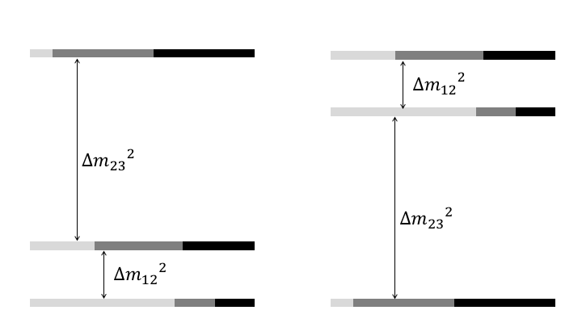
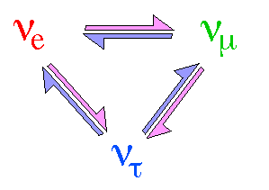
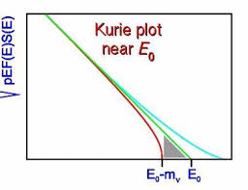
Frontiers 1
Neutrino Masses and Mass Differences
Notes:
There are three neutrinos and we have observed what is called neutrino oscillations (we will discuss this later). This phenomena occurs if the three neutrinos have mass, but is dependent on the mass difference, not the actual neutrino mass. Experiments to determine the neutrino mass use the beta decay spectrum from radioactive decay measuring the end point as shown in the lower figure.

Slide 29
Frontiers 1
Physics – An Inquiry Based Science
Physics of the Universe Report: “Connections Quarks to the Cosmos” Some Questions
How Do Cosmic Accelerators Work and What Are They Accelerating?*
Physicists have detected an amazing variety of energetic phenomena in the universe, including beams of particles of unexpectedly high energy but of unknown origin. In laboratory accelerators, we can produce beams of energetic particles, but the energy of these cosmic beams far exceeds any energies produced on Earth.
Notes:
The mechanisms and existence of high energy cosmic rays gives us information for the mechanisms in the sources. Read the slide.

Slide 30
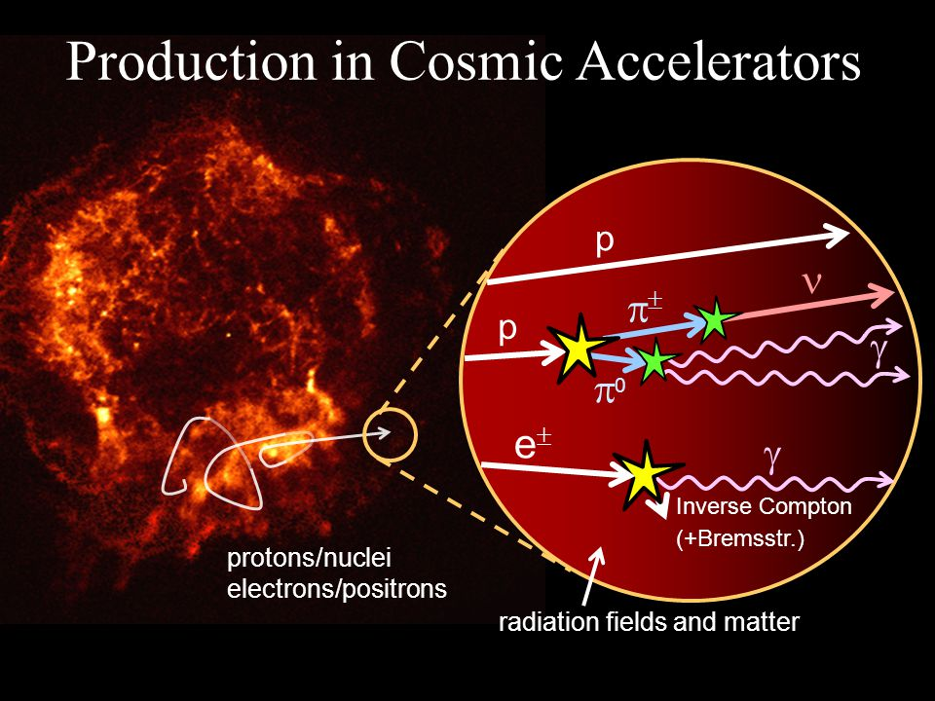
Notes:
Some mechanisms for the acceleration of particles in astrophysics sources. Protons can be produced in nuclear reactions and accelerated in electric fields. Collisions and decays can produce pi-mesons, photons, etc.

Slide 31
Frontiers 1
Physics – An Inquiry Based Science
Physics of the Universe Report: “Connections Quarks to the Cosmos” Some Questions
Are Protons Unstable?
The matter of which we are made is the tiny residue of the annihilation of matter and antimatter that emerged from the earliest universe in not-quite-equal amounts. The existence of this tiny imbalance may be tied to a hypothesized instability of protons, the simplest form of matter, and to a slight preference for the formation of matter over antimatter built into the laws of physics.
Notes:
We believe that is the proton is unstable and we can discover that, it will give us some firm information to understand why we live in a matter dominated universe.
Read the slide

Slide 32

Frontiers 1
How did the Universe Begin and then Evolve?
Notes:
Our picture of the evolution of the universe is seen in this picture. It began 13.77 years ago, the so-called big bang. Near the beginning we had various quantum effects and then to explain the later observatons a period of inflation. Inflation is a mysterious exponential expansion of space and we cannot characterize it very well, but is needed to explain the conditions at later time. We cannot observe before about 370,000 years after the big bang. After that we have many observations from astrophysics that gives us a picture of the stars, then galaxies, planets, etc. In the present era, we observe that most of the matter is dark matter and that the acceleration of the expansion implies that there is also “dark energy” which we seek to understand.
We will spend quite a bit of time later in the course on what we understand and how about this picture and what are the uncertainties and questions.

Slide 33
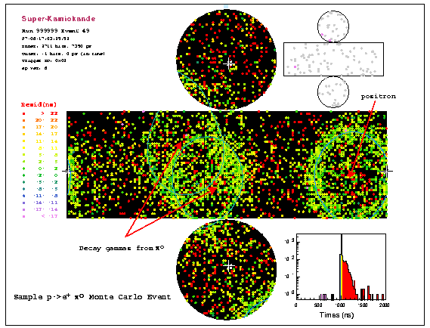
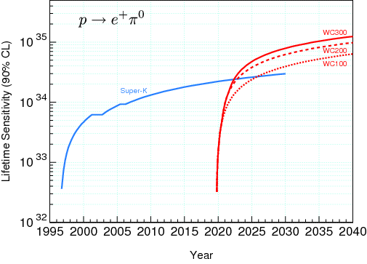
Frontiers 1
Proton Decay Experiment – Kamioka, Japan
Notes:
The most ambitious experiment to try to determine whether the proton has a finite lifetime is the Kamioka experiment in Japan. It is a huge volume of ultra-pure water viewed by a very sensitive array of phototubes. Shown in the figure is a decay of a proton into positron and neutral pion. The pion decays into two gamma rays. These are detected by what is called Cerenkov radiation, which occurs when a charged particle goes faster than the speed of light in a medium.

Slide 34
Frontiers 1
Future Proton Decay Experiment – Hyper -Kamioka, Japan
Notes:
This is the ambitious future project in Japan – Hyper Kamiokande, very recently approved and funded. Kamiokande is the name of the mine in the mountains of Japan. Already there has been the Kamiokande neutrino detector that established neutrinos come from the sun, which is because the sun burns by the nuclear fusion process, and neutrinos emerge from the decays of unstable particles made in this process.
Then a larger more sophisticated version was built, called Super-K and this experiment was instrumental in discovering that neutrinos have mass and decay from one type to another.
And now, the Japanese have recently approved embarking on yet more ambitious detector, Hyper-K, that can test the most subltle but important conjectures around neutrinos. What is the mass ordering and does it got in the same sequence as the electron, muon and tau leptons? Or not??
Finally, it will provide the most sensitive search yet for whether the proton has a finite lifetime.

Slide 35
Frontiers 1
Physics – An Inquiry Based Science
Physics of the Universe Report: “Connections Quarks to the Cosmos” Some Questions
What Are the New States of Matter at Exceedingly High Density and Temperature?
The theory of how protons and neutrons form the atomic nuclei of the
chemical elements is well developed. At higher densities, neutrons and
protons may dissolve into an undifferentiated soup of quarks and gluons,
which can be probed in heavy-ion accelerators. Densities beyond nuclear
densities occur and can be probed in neutron stars, and still higher
densities and temperatures existed in the early universe.
Notes:
Understanding the physics of the early universe means knowing the nuclear physics under extreme conditions of pressure and temperature. This can be achieved on accelerators, for example the RHIC (relativistic heavy ion collider) at Brookhaven National Laboratory on Long Island, New York.
Read text on slide.

Slide 36
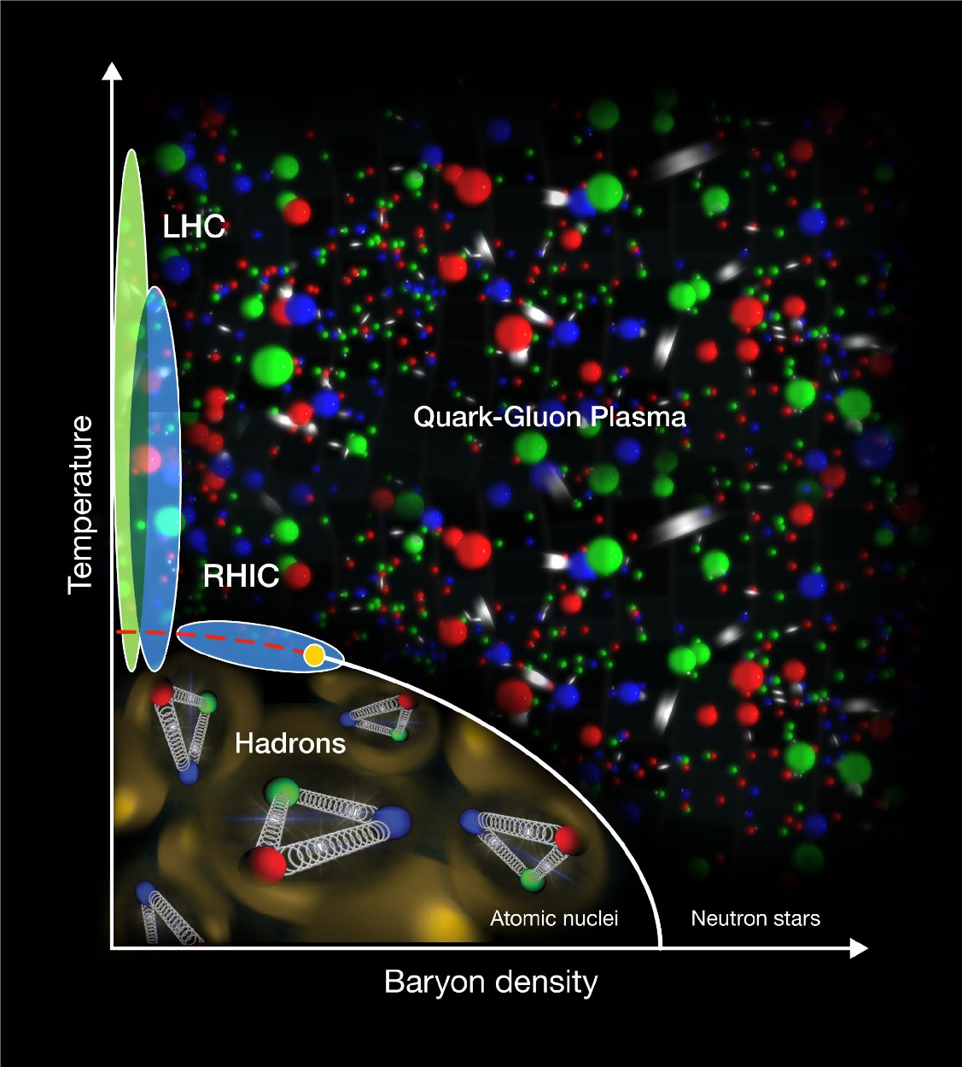
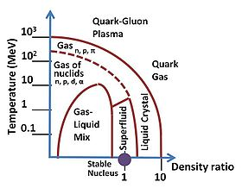
Frontiers 1
Quark Gluon Plasma
Notes:
This figure illustrates the region of temperature and particle density that exists in the early universe. This region is called the quark-gluon plasma, because it is described theoretically as a plasma. Different regions are indicated – neutron stars,atomic nuclei, quark gluon plasma and the region accessible by RHIC. They have established that a quark-gluon plasma exists.

Slide 37
Frontiers 1
Physics – An Inquiry Based Science
Physics of the Universe Report: “Connections Quarks to the Cosmos” Some Questions
Are There Additional Space-Time Dimensions?
In trying to extend Einstein’s theory and to understand the quantum
nature of gravity, particle physicists have posited the existence of space-time dimensions beyond those that we know. Their existence could have implications for the birth and evolution of the universe, could affect the interactions of the fundamental particles, and could alter the force of gravity at short distances.
Notes:
String theory is a very popular area for theoretical physics. It solves many theoretical problems, but involves extra dimensions (e.g. eleven), which may or may not be visible. This opens up the whole question of the existence of extra dimensions beyond the three space and one time dimension of our everyday world.
But, since we live in a four-dimensional world, the other dimensions, if they exist, must be hidden (curl up on the themselves). It is not unique how this happens, so the ability of string-theory to predict of explain phenomena in our world is very limited. As a result, since this course is from an experimental perspective, I will not cover much about string theory during this course.

Slide 38
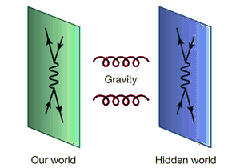
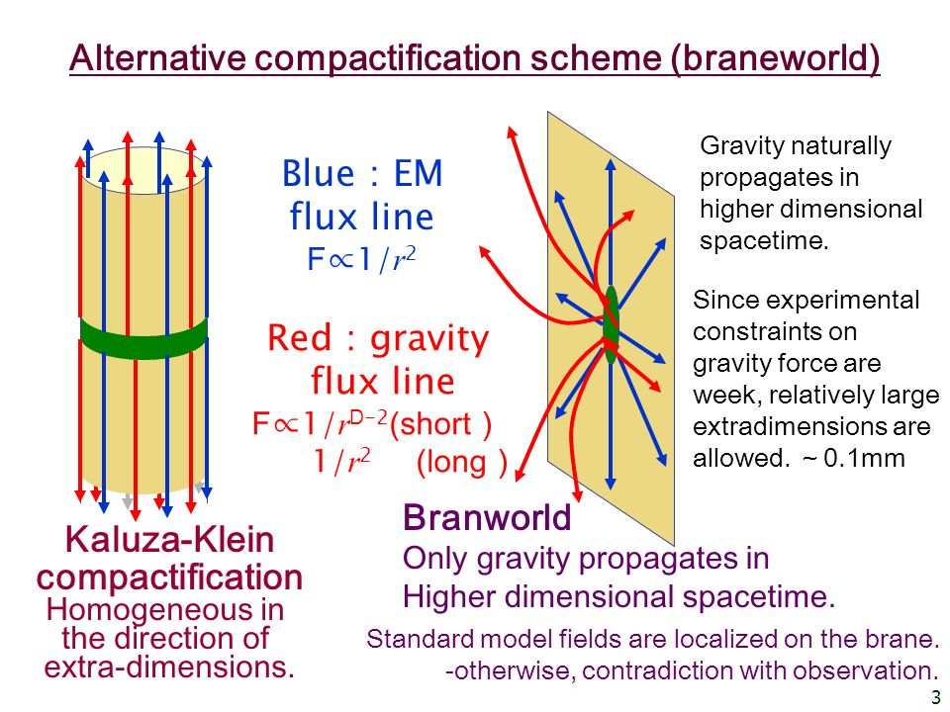
Frontiers 1
Extra Dimensions
Notes:
Some illustrations of extra dimensions. See slide – hidden worlds and extra dimensions in various theories.
Talk to text on the slide.

Slide 39
Frontiers 1
Physics – An Inquiry Based Science
Physics of the Universe Report: “Connections Quarks to the Cosmos” Some Questions
How Were the Elements from Iron to Uranium Made?*
Scientists’ understanding of the production of elements up to iron in stars and supernovae is fairly complete. Important details concerning the production of the elements from iron to uranium remain puzzling.
Notes:
It has been a puzzle for many years where the heavy elements (beyond iron) came from in the earth. We know that most of the universe is made from hydrogen and helium. We also know that heavier elements are made in the burning of stars. The burning is through the nuclear fusion process, and begins with the light elements and keeps going up to iron, but does not produce in any abundance elements beyond iron.
Some are produced though more exotic nuclear physics processes, like what is called the r-process. But, it has still difficult to reconcile the abundances of heavy elements. The recent observation by LIGO (my gravitational wave experiment) of a merger of a binary neutron star system, may well be a much more prolific source of heavy elements. It will take more observations to determine how valid this explanation is.

Slide 40
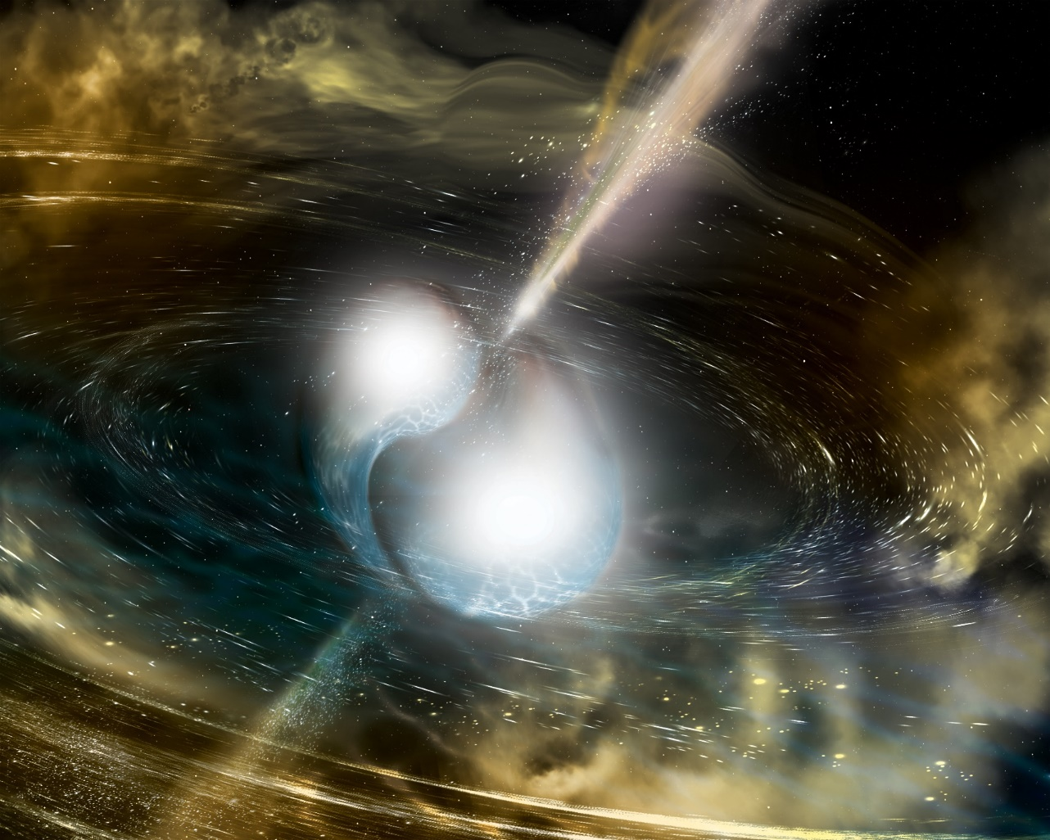
Frontiers 1
Binary Neutron Star Merger Produces Heavy Elements
Notes:
An artists view of the merger of two neutron stars. This spectacular collisions can be viewed and experimentally probe nuclear physics in the most extreme conditions.
Neutron Stars are objects of very compact nuclear matter. They result from the collapse of a star, called a supernova. After a star burns it fuel by the fusion process, gravity pulls it into a 20 mile diameter object of nuclear matter having a mass of about 1.4 times the mass of the earth. Observing the collision is a new probe of nuclear physics in the most extreme conditions.

Slide 41
Frontiers 1
Origin of the Heavy Elements?
Notes:
In the laboratory, we have made many heavy elements beyond iron. Generally, the technique is to bombard neutrons on heavy elements and that produces yet heavier ones and we have filled out the periodic table using those techniques. Physicists have conjectured that in the fusion burning of stars, there is a process that enhances the production of heavy particles – the “r-process.” Now that neutron star collisions have been observed the alternate mechanism that such collisions in the distant past made the heavy elements we find in the earth. It will take many more observations of neutron star collisions to determine if that is correct.

Slide 42
Frontiers 1
Origin of the Heavy Elements?
Neutron Star Mergers are Incredible Gold Factories
LIGO observed Neutron Star Merger produced
~ 100 Earth Masses of Gold
Notes:
Show slide, read test

Slide 43
Frontiers 1
Physics – An Inquiry Based Science
Physics of the Universe Report: “Connections Quarks to the Cosmos” Some Questions
Is a New Theory of Matter and Light Needed at the Highest Energies?
Matter and radiation in the laboratory appear to be extraordinarily well described by the laws of quantum mechanics, electromagnetism, and their unification as quantum electrodynamics. The universe presents us with places and objects, such as neutron stars and the sources of gamma ray bursts, where the conditions are far more extreme than anything we can reproduce on Earth that can be used to test these basic theories.
Notes:
Read from the slide

Slide 46
Frontiers 1
So, we have seen some of the main questions physicists were grappling with at the turn of this century. Some have been answered and some have not, and I will explore many of those during the course.
But, first, let’s look a little at
“What We Know!!”
Notes:
Read the text

Slide 47
Frontiers 1
What we know: Evolution of the Universe
The universe today is the product of a long chain of events, as shown in this artists conception of cosmological evolution beginning with the big bang. We study both the chronology and the causal connections.
Notes:
Read from the slide.
The causal connections and chronology are our best glues as to the evolution of the universe. The other important point is ‘what do we know’ The combination, plus the development of new experimental tools, presents us with the opportunities to make fundamental advances in physics in the future. What we know about the evolution of the universe. Of course, the converse what don’t we know is equally important.

Slide 48
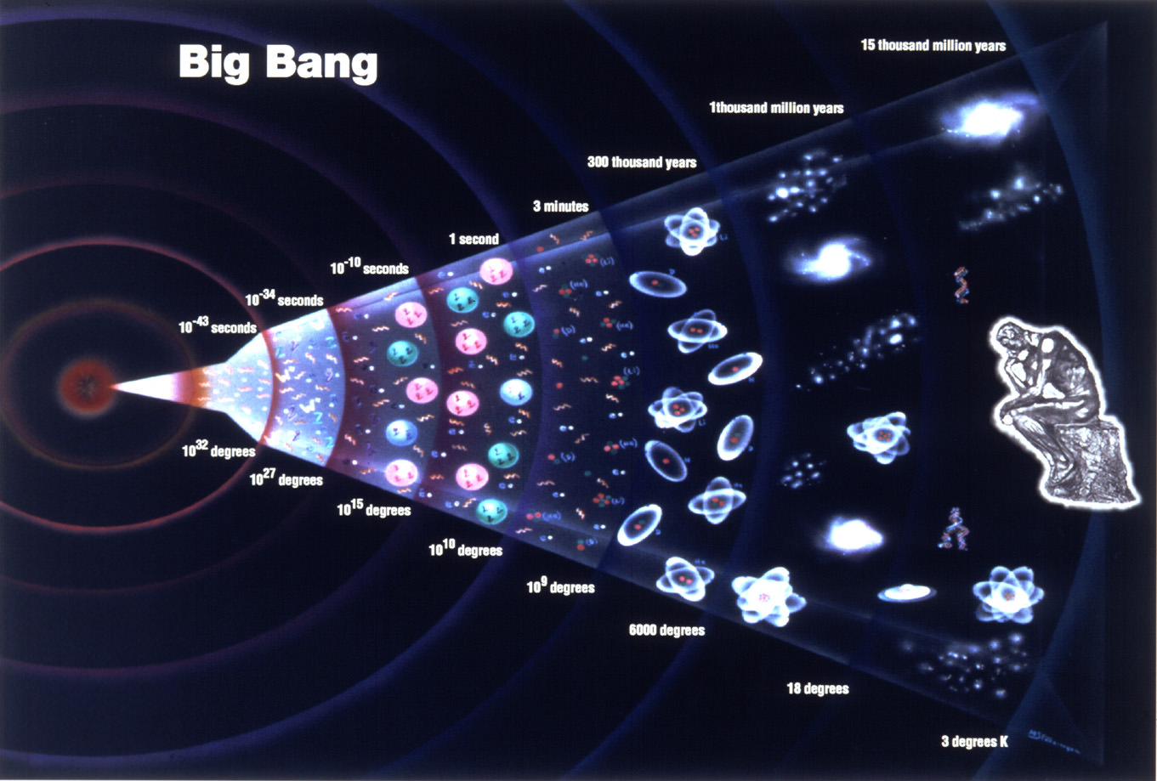
Frontiers 1
Frontiers 2
Notes:
Shown in this figure is what we know about the history of the universe in temperature, and in creating particles, stars, galaxies, etc over the history since the big bang. Some of this figure is better known than others, coming from hard experimental facts and the combination of real observations and our best extrapolations of the science, gives us our understanding of the evolution of the universe.
Other parts are our inferred picture. Certainly the early universe is not known directly, but inferred, because the furthest back we can look experimentally is about 400,000 years after the big bang, as the universe was too dense and key information, like the cosmic microwave background experiments cannot look directly before that time.

Slide 49
Frontiers 1
Frontiers 2
What we know: The Vacuum
According to the rules of quantum field theory, the vacuum is not empty but it is actively populated by particle-antiparticle pairs that appear, annihilate, and disappear, existing fo only brief instants.
Notes:
What we know about the vacuum. IT IS NOT EMPTY!!! Read slide.

Slide 50
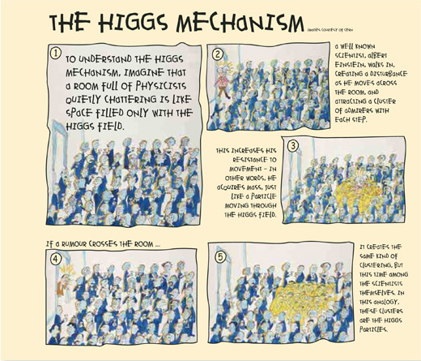
Frontiers 1
Frontiers 2
Notes:
Since this 2002 report, we have discovered the Higgs Particle at CERN (We will describe the discovery later). This is motivated by the Higgs Field, which describes the vacuum and its ability to create mass. Read cartoon.
We will discuss the discovery of the Higgs Boson at the CERN Large Hadron Collider.

Slide 51
Frontiers 1
Frontiers 2
What we know: The Elementary Constituents and Forces
The fundamental particles include both the fermions, the matter particles, and bosons, the force carriers. Masses of all particles are given in GeV/c², a unit in which the mass of the proton is approximately 0.94, electric charge is listed in units of the electron charge. The Higgs particle discovered after this chart (e.g. 2012)! Is added to the bosons. Also, neutrino mass must be added.
Notes:
We have learned a lot about particles and fields. This figure summarizes what we know about the fundamental particles and their interactions. Read the slide.

Slide 52
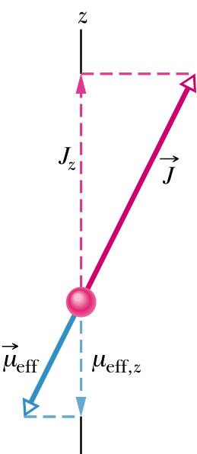
Frontiers 1
What we know: Particle Classification by Spin
Charged leptons have magnetic moments characteristic of point-like particles, hadrons have very different magnetic moments!
Notes:
Now, over the next few lectures we will explain both how the standard model of particle physics has evolved and the evidence for the different parts. Later, we will look at why it is a “model” not a theory, and some of the future probes toward revealing the physics beyond the standard model.
There are many features of elementary particles and their interactions that have been essential in understanding particle physics. As a first example, the particles we observe in the laboratory (accelerators) have a quantum feature we call the spin that is intrinsic and distinguishes the different particles.
So, first … what is spin? See description on the slide.

Slide 53
Frontiers 1
What we know: Isospin - Important Classification Property
Isospin Space - Analogous to the properties of Spin
Leptons comprise three families with individual conserved lepton family numbers: L_{e}, L_{μ}, and L_{τ}.
L_{e}, L_{μ}, and L_{τ} conserved in all known processes!
Q conserved in all known processes!
Different family members differentiated by isospin component.
“Weak charge” of leptons correlated with I₃.
Notes:
Total Isospin (I) of each lepton is sqrt(3/4)
Imagine an abstract space, which obeys similar laws as that of spin angular momentum. So ν and e are analogous to up and down charged particles (like electrons) in magnetic fields.
The different masses within a family are due to breaking of the isospin symmetry (in Weak Interactions)
But each family is specified by a total Lepton family number (+1 for particles above): Electron, Muon, & Tau numbers
The antiparticles have the opposite values of L, the opposite values of I3 and the opposite values of Q.

Slide 54
Frontiers 1
Isospin and Baryon Number are Important Classification
Property for Leptons
We have proton, neutron, and pions. The proton and neutron obviously related.
The free neutron is not stable, but decays to proton (and e and ν) by Weak Interaction.
The free proton is stable!!! (τ > 10³⁵ years) [BUT IS IT??]
Baryon number is conserved!
Notes:
Hypothesize that strong interactions do NOT depend on I₃.
The charge of Strong Interactions is something different!
Turn off Weak Interactions and Electromagnetic Interations, then the p and n look exactly the same, same mass, no electric charge (or other EM properties), ...!
The breaking of the isospin symmetry (e.g., slightly different masses), occurs because of the EM and WI, making the masses slightly different. But clearly, MOST of the nucleon mass comes from the Strong Interactions. The breaking causes a PERTURBATION which is about 1.3 MeV out of 1000 MeV … not a large effect.

Slide 55
Weak Interactions and Isospin
Frontiers 1
Interesting feature of Leptons: Spin 1/2 and Isospin ½
Weak Interaction charge I₃
Lifetimes and cross-sections depend on G_{F}
Notes:
Particles come in what we call families. This slide illustrates this for three families of leptons. Each family has two particles, a charged lepton and a neutral, almost zero mass, neutral lepton, we call a neutrino.
Read features on the slides

Slide 56
Frontiers 1
Hypothesis: Weak Boson of Finite Mass Carries Weak Force
Notes:
Feynman diagrams showing the interaction of particles. Time flows to the right, the vertices are where we calculate the strength of the interactions and the wavy line in the middle is the interaction between the particle on the top and the one on the bottom.
On the left is the electromagnetic interaction between an electron and a proton, in other words, describes the scattering of an electron on a proton. It is characterized by an exchange of a virtual particle, in this case the photon and the strength is proportional inversely to the square of the momentum transferred between the electron and proton.
On the right is the weak scattering, which is by its name much weaker as described on the bottom of the slide.

Slide 57
Frontiers 1
Electroweak Synthesis by Glashow, Weinberg and Salaam
Specific Theory based on Electromagnetic and Weak Forces characterized in simplest case by
massless force particles
massless matter particles
same couplings
Hypothesize that mass is acquired through a NEW force: “Higgs” field
Specific and clear predictions:
W± bosons carry known (charged current) weak interation.
Z⁰ boson carries new (neutral current) weak interaction.
Notes:
The big synthesis was that of Glashow, Weinberg and Salam, who were awarded the Nobel prize by unifying electromagnetic and weak forces. Read the slide.

Slide 58
Frontiers 1
Electroweak Synthesis by Glashow, Weinberg and Salaam
Predicted New Neutral Current Weak Interaction
First evidence (Gargamelle,1973) for Neutral Current processes seen in CERN experiment using neutrinos with E ~ 2 GeV – but there were questions ... (single event, under-constrained)
Notes:
The new prediction of the electroweak unified models of Glashow , Weinberg and Salaam was that there would be not only weak reactions that exchanged charged particles, but also neutral ones. This was the key prediction of the weak neutral current. No such reactions had been seen at that time (1970s), either in weak decays of scattering involving the weak interaction.
The left diagram shows electromagnetic scattering of an electron on a proton. The middle diagram shows the scattering I described on the earlier slide of a weak scattering of particles, involving the exchange of a charged weak particle (called the W boson).
On the right is shown the new process involving the exchange of a ‘new’ neutral intermediate particle called a Z boson. The first evidence for such an interaction was produced in the Gargamelle bubble chamber at CERN in 1973, based on one event.

Slide 59
Frontiers 1
PURELY LEPTONIC NEUTRAL CURRENTS
1)I well remember a colloquium held in the small library of
the Gargamelle Building at CERN with P. Musset ,
B. Zumino, J. Prentki and M.K. Gaillard(1972).
Zumino explained us the theoretical fascination of the new
renormalizable theory of Glashow, Salam and Weinberg ,
suggesting the search of the muon neutrino and
antineutrino scattering on electrons.
2)In early January 1973 the Aachen group (H. Faissner, J.
Morfin et al.) observed the famous candidate for the
reaction:

Slide 60
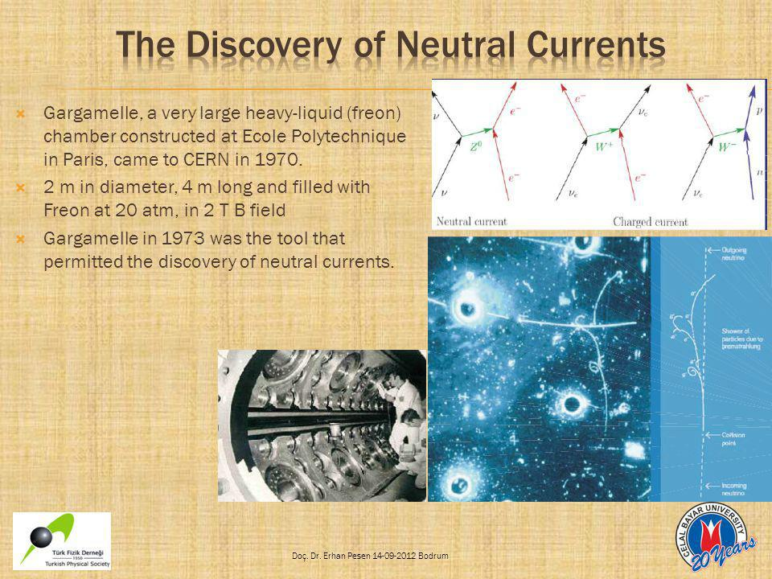
Frontiers 1

Slide 61
The background for this process was really very small and
at this point the overall collaboration was excited and the
search of neutral currents then stood at the center of
everyone’s attention.
3)Let me finally recall the strong pressure exercised by
A. Rousset and A. Lagarrigue to finalize the analysis of the
events (done mainly by J.P. Vialle) and to pubblish a
letter (July 1973).
I PERSONALLY BELIEVE THAT WITHOUT THEIR
STRONG BELIEF THE COLLABORATION WOULD HAVE
DELAYED THE PUBBLICATION OF THIS VERY
IMPORTANT DISCOVERY.

Slide 62
Frontiers 1
Barish and Sciulli Fermilab – Definitive Observation 1974
Weak Neutral Current Established !!
~100 GeV ν_{μ}
~80%
~100 GeV ν_{μ}
~ 20%
1 m Steel
Notes:
I collaborated with Frank Sciulli of Columbia Univesity, but at that time, Caltech, to do the definitive experiment verifying the weak neutral current in neutrino interactions at high energy at Fermilab using a high energy neutrino beam. This was perhaps the key piece of evidence that proved the standard model of particle physics, which we will refer to throughout the course
Describe the slide. This discovery is in the bottom of the slide. Neutrino interactions that do not result in the production of a charged lepton

Slide 63
Frontiers 1
Weak Interaction Parameters → predictions W± and Z⁰ bosons
1983: UA1 colliding beam at CERN
M_{Z}= 91.19 GeV M_{W}=80.4 GeV
Notes:
Then, 10 years later, a dedicated effort was made at CERN to produce and detect this particle, the Z-boson, in the laboratory. The weak propagators, charged W and neutral Z, were discovered by a group led by Carlo Rubbia. He was awarded the Nobel Prize in 1984.
There is much more to come in experiments in the following years:
More refined measurements at CERN and Fermilab
Exquisite measurements of Z at SLAC and CERN LEP

Slide 64
Frontiers 1
Electroweak Unification is an Essential Feature of the Standard Model
Weak and EM Coupling Strengths intimately connected and unify at high energies
Q is the charge of Electromagnetism
I₃ is the charge of Charged Weak Current
Both I₃ and Q provide the charge for the Neutral Current Weak … in predictable way
Masses of the Force Carriers predicted from EM and Weak Interaction are constants
These Masses were verified with incredible precision
Notes:
Read the slide.

Slide 65
Frontiers 1
What we know: Quantum Chromodynamics - Strong Force
Quantum Chromodynamics (QCD) describes the strong force, above over 11 orders of magnitude. The data is from high-energy proton-antiproton collisions at Fermilab’s Tevatron. The production of jets of quark and gluons carries the energy on the horizontal axis, transverse the beam direction.
Notes:
Let me quickly summarize what we know, at least some highlights.
Read the slide.

Slide 66
Frontiers 1
What we know: Discovery of the top quark at Fermilab
The discovery of the top quark at Fermilab. Proton-Antiproton colliqions at high enough energy produce the reaction above/ A pair of top quarks is produced, each of which has about the mass of a gold atom. The top quark decays quickly into lighter particles. The Collider Detector Facility (CDF) is shown above.
Notes:
We also know about the heaviest quark, the top quark or t-quard.
Read slide.

Slide 67
Frontiers 1
What we know: Constituents of the Standard Model
Discovery announced
July 2010
Notes:
We put this altogether into the standard model, summarized in this slide and I will continue to show you what makes up this diagram and what we know and don’t know about some of the key features.

Slide 68
Frontiers 1
Popular Conjecture: Supersymmetry
Possible convergence of the effective coupling strengths for the three forces --- strong, weak and electromagnetic interactions vs energy. For minimal supersymmetry they converge at about 10¹⁵ GeV.
Notes:
A popular (unproven) conjecture is that the fundamental forces of nature come together at sufficiently high energy (unification). This energy is expected to be quite high and a popular model, called supersymmetry brings thee forces together at about 10¹⁵ GeV
Read slide.

Slide 71
Frontiers 1
New Technologies Enable New Discoveries

Slide 72
Frontiers 1

Slide 73
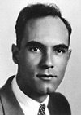
Frontiers 1

Slide 74
Frontiers 1

Slide 75
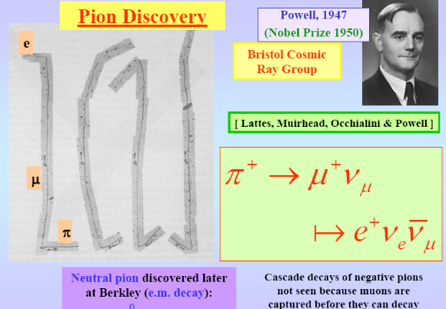
Pion Discovery
Frontiers 1

Slide 76
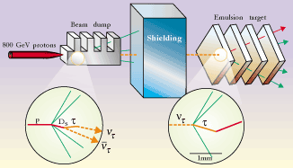
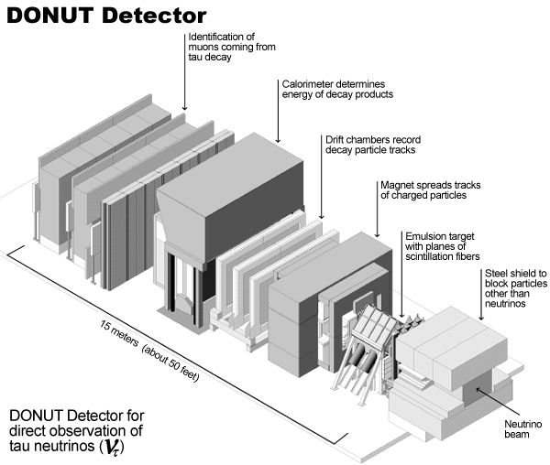
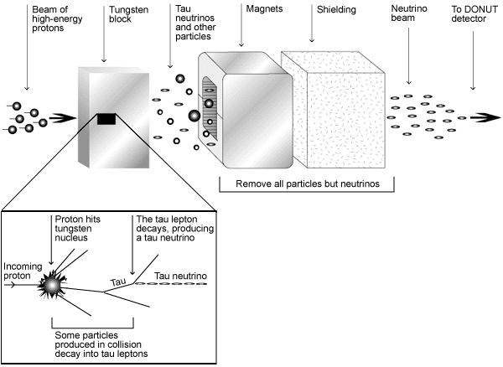
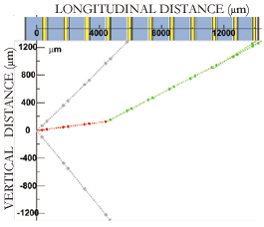
Emulsions & the Nu-tau
Frontiers 1
DONUT (Direct Observation of Tau Neutrino
July, 2000

Slide 77
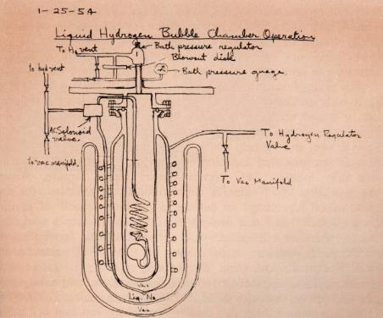


Bubble Chamber & Beer
Frontiers 1
Donald Glazer (1952)
Bubble Chamber
Bubbles form at nucleation sites
in regions of higher electric fields
⇒ ionization tracks

Slide 78



Frontiers 1
Principle of a Bubble Chamber
Donald Glaser
with his Bubble Chamber
1953
“Gargamelle”
An Event – First Evidence for the Weak Neutral Current
Notes:
Fermi, who had invited Glaser to Chicago to find out more about his invention, had already seemingly proved that a bubble chamber could not work. But when Glaser found a mistake in Fermi’s authoritative textbook, he dedicated himself to redoing the calculations.
Glaser found that, if he was correct, that the bubble chamber should work with water. To make absolutely certain he “wasn’t being stupid”, Glaser conducted this curious nocturnal experiment at his Michigan laboratory. He also discovered that the bubble chamber worked just as well when using lager as it had with other chemicals.
There was one practical issue however, the beer caused the whole physics department to smell like a brewery. “And this was a problem for two reasons,” Glaser recalled. “One is that it was illegal to have any alcoholic beverage within 500 yards of the university. The other problem was that the chairman was a very devout teetotaler, and he was furious. He almost fired me on the spot”.

Slide 79


Bubble Chamber
Frontiers 1
Liquid superheated by sudden expansion
Bubbles allowed to
grow over ∼ 10ms
then collapsed during
compression stroke
hydrogen,
deuterium,
propane
Freon

Slide 80

Bubble Chamber Pros & Cons
Frontiers 1
Frontiers 2
Discovery of the Omega Minus
Acts as both
target & detector
Difficult to trigger
Track digitization
cumbersome
High beam intensities
swamp film images
Mechanically Complex
Slow repetition rate

Slide 81

Basics of Ionization Detector
Frontiers 1
Ionization Detectors
Medium must be chemically inactive
Electric field imposed to
prevent recombination
and have a low ionization threshold
(so as not to gobble-up drifting electrons)
(noble gases often work pretty well)

Slide 82

Ionization Regimes
Frontiers 1
heavily
ionizing
particle
minimum
ionizing
particle
Acceleration causes
avalanch of pairs
signal smaller
than initially
produced pairs
signal reflects
total amount
of ionization
leads to discharge
where signal size
is independent of
initial ionization
initially free electrons
accelerated and further
ionize medium
such that signal is
amplified proportional
to initial ionization

Slide 83

Frontiers 1

Slide 84

Frontiers 1

Slide 85
Frontiers 1

Slide 86
Frontiers 1

Slide 87
Frontiers 1

Slide 88

Time Of Flight
Frontiers 1
Time Of Flight (TOF): An Application of Prompt Timing
Used to discriminate particle masses)
t = Lc/β
Δt = Lc (1/β₁ − 1/β₂)
β² = 1 − 1/γ²
1/β = ( 1 − 1/γ² )^{−1/2}
≃ 1 − 1/(2γ²)
Δt ≃ Lc/2 (1/γ₂² − 1/γ₁²)

Slide 89

Advances in Computing Great Discoveries in Physics
Frontiers 1

Slide 90
Frontiers 1

Slide 91
Frontiers 1

Slide 92
Frontiers 1

Slide 93



Collider Detector Configuration
Frontiers 1
High Energy Particle
Detectors

Slide 97
Frontiers 2
Collision of 300 GeV protons on stationary nucleon
New kinds of particles are made out of the kinetic energy: mesons (pions) with mass of 140 MeV each.
These secondary particles are made prolifically, by the Strong Interactions. Clearly they are not nucleons
But they are hadrons!
Notes:
Read Slide

Slide 98
Frontiers 2
Can we use Isospin for Pions? YES
Notes:
Read slide.

Slide 99
Frontiers 2
Lifetimes are Important
Particles decay when they can !
(That is, the decay is not forbidden!)
The lifetime gets shorter (or decay rate gets larger) with increase of either
energy release
strength of the responsible force
The uncertainty principle requires that the mass of the particle be uncertain by
Notes:
Read slide

Slide 100
Frontiers 2
How Uncertain are Particle Lifetimes
proton
neutron
π±
π⁰
???????
Strong
Notes:
Here we see the formula and a table of the lifetimes of well known particles. Note the huge differences in lifetime. This has to do with which are allowed to decay strongly, electromagnetically or weakly.
Point to the formjla, and show features in table
1) Big differences in liftetimes and mass uncertainty for Weak, Electromagnetic and Strong forces

Slide 101
Frontiers 2
Experiment Colliding a beam of p on a stationary target of protons
Experiment colliding beam π and stationary p
E , p = pion total energy, momentum
p
When E_{cm}~ M_{Δ} , interaction rate increases dramatically
E_{cm}
Notes:
For many years most experiments collided a moving particle from an accelerator on a fixed target and much was learned that way, but following the formula the energy range is limited since it varies like E squared goes like 2 ME.
Describe slide, figure and formula.

Slide 102
The First Resonance Discovered!
Frontiers 2
Energy width, Γ, gives lifetime
Kinetic Energy peak, E₀-m_{π}
Notes:
During the late ‘40’s, early ‘50’s, big competition. How far one could go depended on how high in energy your accelerator could go!
J=3/2 means (since j1=0 and j2=1/2), that l=1. Hence, called a p-wave resonance. Can tell from decay distributions.
Spin algebra permitted calculation of relative decay mode probabilities: eg pi+ n makes delta+ decays to
pi+ n
pi0 p
Relative probabilities predicted and verified.
The dotted curve shows the “unitarity limit”, when all the pions within a radius of proton corresponding to l=1 is absorbed.

Slide 103
Frontiers 2
My Thesis – Inelastic Production of the First πN Resonance
Notes:
My thesis was looking at this famous first resonance Delta 3,3, but in inelastic collisions.

Slide 104
Frontiers 2
My Thesis – Inelastic Production of the First πN Resonance
Experimental Setup at the Berkeley 184-inch Cyclotron
Notes:
This figure shows the layout for my thesis experiment.
The beam of negative pions come from the left.
After passing thrugh a shielding wall they impinge on a Liquid Hydrogen target, another words protons.
They interact and I analyzed the product scattered pions in a telescope shown where the number, scattering angle and energy could be recorded.

Slide 105
Frontiers 2
My PhD Thesis
Inelastic Production of the First πN Resonance
Inelastic Pion Scattering. The data showed climbing the peak, early evidence for producing the Δ(1238) resonance.
Good enough for a PhD thesis!!
Notes:
This was the result.
The cross section increased just as expected for a resonant state, but because the energy of the accelerator was not high enough, it did not reach maximum.
Read slide.

Slide 106
Frontiers 2
Many Pion + Proton Resonate States
These are just the tip of the iceberg:
At least twenty πN states with mass< 2200 MeV.
All decay with short lifetimes because they decay by Strong Interactions
Notes:
From other experiments the production of may resonant states was found.
The isospin 1/2 states are called N
the isospin 3/2 states are called Δ
All recurrences have higher spins

Slide 107
Frontiers 2
Events with Many Pions, Many Resonances
ρ-meson
ω-meson
About 40 such strongly decaying mesons with mass less than 2500 MeV now observed
Notes:
Again, these are higher spin than the pi.
Rho and omega have spin 1 (along with others)
Rho is isospin 1 (like pi); omega is isospin 0 (only neutral)
Many others with even higher spins.

Slide 108
Frontiers 2
Early on there were other “Strange” events
First observed (1947) by Rochester and Butler in Cloud Chamber of “vee” events ... (kinks)
kink
3 cm Pb plate
3 cm Pb plate
gaps
Notes:
Read slide.

Slide 109
Frontiers 2
Bubble Chamber Event Illustrating Strange Events
Force
Strong
weak
weak
Notes:
Cross section for production is strong (millibarns), or characteristic lifetime of production of order 10⁻²³
Where decays, to Strange particles, are long-- of order 10⁻¹⁰

Slide 110
Frontiers 2
Description – Strangeness Quantum Number (S)
singlet: one
charge state
doublet: two
charge states: K⁰ , K⁺
Notes:
Read slide

Slide 111
Frontiers 2
Strange Baryon and Meson States (Lowest Mass)
Notes:
The strange baryon characteristics. Read slide.

Slide 112

Frontiers 2
History of Particle Discoveries (1930 – 1965)
Notes:
As the more and more particles were discovered, each with different quantum numbers, it became difficult to understand how all of this fit together somehow?

Slide 113

Frontiers 2
There are many Higher Mass (Stongly Decaying) Strange States
Existence of these excited states (or levels) indicates compositeness (like atoms and nuclei)
strong decays
weakly decaying
Notes:
In atoms, levels are eV apart
In nuclei, levels are MeV apart
For “particles”, levels are hundreds of MeV apart

Slide 114
These were exciting times, discovering all of the elementary particles! BUT, so many particles and rules could almost get boring!
Frontiers 2
We needed good ideas to bring order to the field!!!
Notes:
Read text

Slide 115
End?

Slide 116


Gell-Mann’s “Eightfold Way”
Frontiers 2
Murray Gell-Mann proposed that nature had an organizing scheme for the rapidly growing set of elementary particles based on the “eight fold way” For example, the lightest baryons are arranged into a hexagonal array shown below
Murray Gell-Mann
Notes:
Ne’eman had similar idea at same time

Slide 117
Gell-Mann’s “Eightfold Way”
Frontiers 2
The group algebra (SU3) grouped the hadrons into natural octets and decimets
Predicted η, which was found few months later
Also, the expected Ξ’s, were found in 1962
The big test was yet to come!
Notes:
Ne’eman had similar idea at same time

Slide 118
Frontiers 2
N
Gell-Mann’s Predicted the Mass, Lifetime, Decay Modes of the yet to be discovered Ω⁻
The Decimet: J=3/2
Strangeness = -3 baryon … Gell-Mann: “At 1685 Mev/c², it will be metastable and decay by weak interactions into π⁻ + Ξ^{0.”}
Notes:
1962-63: Unambiguous prediction of omega minus: mass, lifetime, decay modes,

Slide 119
Frontiers 2
The Ω¯ was discovered in 1964 by Samios, Willis, et al, exactly as predicted
100,000 pix of K⁻p interactions from a single (highly constrained) event,
M_{obs}=1686±12
τ~10⁻¹⁰ sec
Thousands of Ω⁻ have been seen since!

Slide 120

Frontiers 2
Gell-Mann had successfully
Classified the Elementary Particles
The Eightfold way not only classified the hadrons, but provided a structure.
This was the beginning of developing real theories of particle physics

Slide 121
Frontiers 2
Gell-Mann & Zweig (1964) conjectured the base states for the hadrons were built from ‘quarks’

Slide 122

Frontiers 2
Quark Properties in the Eightfold Way
The Proton
“Valence Quarks”

Slide 123

Frontiers 2
Quarks
The quark model:
Baryons and antibaryons are bound states of 3 quarks
Mesons are bound states of a quark and an anti-quark
Baryons and Mesons are: Hadrons

Slide 124
Quarks
Frontiers 2
Quarks are s = ½ fermions, subject to all kind of interactions.
They have fractional electric charges
Quarks and their bound states are the only particles which interact strongly
Like leptons, quarks occur in 3 generations:
Corresponding antiquarks are:

Slide 125

Hadrons
Frontiers 2

Slide 126

Frontiers 2
Baryons
Strangeness is defined so that S=-1 for s-quark and S =1 for the anti s-quark. Further, C=1 for c-quark, B=-1 for b-quark and T=1 for t-quark
Since t-quark is a very short living one, there are no hadrons containing top, i,e, T=0 for all
Quark numbers for up and down quarks have no name, but just like any other flavour, they are conserved in Strong and EM interactions Baryons are assigned own quantum number B: B=1 for baryons, B=-1 for antibaryons, B=0 for mesons

Slide 127

Particles and Interactions
Frontiers 2

Slide 128

Hadron Lifetimes
Frontiers 2

Slide 129

Frontiers 2
Hadron Lifetimes
Mesons
Majority of hadrons are unstable and tend to decay by the strong interaction to the state with the lowest possible mass (τ ~ 10⁻²³ s)
Hadrons with the lowest possible mass for each quark number (S, C, etc.) may live much more before decaying weekly (τ ~ 10⁻⁷⁻ 10⁻¹³ s) or electromagnetically (mesons, τ~10⁻¹⁶⁻ 10⁻²¹ s)
Such hadrons are called stable particles

Slide 131

Frontiers 2
But, Are the Quarks Real???
Searches for free quarks have all been negative.
Quarks are confined!

Slide 132
Frontiers 2
Detecting Quark Structure
Strange, charmed, bottom and top quarks each have an additional quantum number: strangeness S, charm C, beauty B and truth T respectively.
In strong interactions the flavour quantum number is conserved
Quarks can change flavours in weak interactions (ΔS =±1, ΔC =±1)
Theory postulated in 1964 (Gell-Mann)
e’
e
In the 70’s, deep inelastic scattering of electrons on p
and bound n show evidence for the quark model
p

Slide 133
Frontiers 2
Scattering with leptons (electrons or neutrinos) reveal hard point-like structures (Deep Inelastic Scattering)
u
e⁻
e⁻
u
ν_{μ}
μ⁻

Slide 134
Frontiers 2
Quark Charges in the Nucleon (?)
By mid-1970’s: Fractionally Charged Constituents even when normalized to neutrino
energies beyond 100 GeV

Slide 135

Frontiers 2
Measurements of the Nucleon Quark Densities
xP
P
30 years of deep inelastic experiments (DIS) with fixed target eN, νN, μN; collider eN (HERA)
Measure fractional momentum probability of each quark flavor
Tested hypotheses of strong force binding quarks

Slide 136
Quark Densities of Proton vs x
Frontiers 2
Probability of finding a quark of any type inside the proton
versus the fraction of the proton momentum carried by that quark
1988 - CCFR
Note linear x-scale

Slide 137
Are the quarks ‘real’?
Frontiers 2
The properties of the quarks (charge, spin, …) repeatedly measured in many kinds of processes.
Experiment validates their existence.
Experiment measures the motions of the quarks in the proton

Slide 138
End?

Slide 139
Determine Proton Innards in Similar Way to Rutherford Atom
Frontiers 2
The scattered innards have fractional charge
They also have spin 1/2
Three valence quarks inside the proton
Only about half of proton momentum carried by quarks
What’s all this stuff?
Note log x-scale

Slide 140

Frontiers 2
Lower q²
see more and more of “sea”

Slide 141
What About the Forces Holding These Quarks Together?
Frontiers 2
What carries the force?
What is the “charge” that makes quarks engage in the strong force?
How do we get the quarks out of the hadron?
What are the masses of the valence quarks?
What carries this strong force (analogous to the EM force carrier: photon)
QCD
“Color”
Cannot
Small
Gluon
QCD = Quantum ChromoDynamics (QCD)
A Great Triumph of Theory! Born out by Experiment!

Slide 142

Science of Confinement
Frontiers 2
The spectroscopy of light mesons led to the quark model and QCD: mesons are quark-antiquark color singlet bound states held together by gluons.
QED
The gluons of QCD carry color charge and interact strongly (in contrast to the photons of QED).
QCD
Bound states involving gluons should exist – but solid experimental evidence is lacking.

Slide 143

Color - A Word Referring to the “Three Different Charges” of the Strongly Interacting Quarks
Frontiers 2
eg: white =
red+anti-red
red+blue+green
Only white (color-neutral) hadrons can exist!
Why? Because of the nature of the color force.

Slide 144
Force between colored quarks carried by gluons
Frontiers 2
EM Force
QCD Color Force

Slide 145

Why can’t the quarks get out??
Frontiers 2
Constant force × distance = infinite work !!!
Nonsense … something has to give, and it does!
New q and anti-q pop out of vacuum
now 2 pions!
Consider meson … pulling q and anti-q further and further apart!

Slide 146

Strong Coupling Constant gets bigger at larger distances
Frontiers 2

Slide 147

QCD, Color, and Gluons More Complicated than QED, Charge, and Photons
Frontiers 2
Photon has no electric charge
Gluons each have TWO color charges!

Slide 148

“There are many Experimental Triumphs of QCD
Frontiers 2
Q² dependence in deep inelastic scattering
Universal applicability of quark and gluon densities
Gluon jets in e⁺e⁻ collisions
Elementary
process
What we see
Collider experiments with high energy electrons and positrons colliding!!!!

Slide 149


Picture of proton from Deep Inelastic Scattering experiments
Frontiers 2

Slide 150

Use Quark Density to Calculate p-pbar interaction
Frontiers 2
p
Anti-p
Notes:
DIS experiments measure contents (including gluons)
QCD predicts all the q-q and g-g and q-g cross-sections
Curve a prediction, pts measured.

Slide 151

u and d Quarks Have Very Low Mass
Frontiers 3
Ξ*
Pts: calculations of mesons and baryon masses, assuming u and d quarks m=0.
Lines: actual values.
Masses of u and d probably of order few MeV
Ξ
Δ
Σ
Ω
Λ
φ
Σ*

Slide 152

All Agree that QCD is a Very Elegant Theory
Frontiers 2
D Gross, F Wilzek and D Politzer

Slide 153


All Agree That Nucleon Not Simple: A Very Dynamic System
Frontiers 2
Lots and Lots of Low Mass Quarks (few MeV)
and Gluons (zero MeV) Travelling Relativistically
(total energy = proton mass = 1 GeV

Slide 154

Proton Spin Structure Even More Complicated Not like the Quark Model
Frontiers 2

Slide 155
Week 2 B
Notes – Gargamelle slide 23

